Slide 1


Chapter 2
Fundamentals of the Analysis of Algorithm Efficiency
Section 2.1. Analysis Framework
Copyright © 2007 Pearson Addison-Wesley. All rights reserved.

Slide 2
Section 2.1. Analysis Framework
Issues and Approaches
Measuring an Input’s Size
Units for Measuring Running Time
Orders of Growth
Worst-Case, Best-Case, and Average-Case Efficiencies

Slide 3
Issues and Approaches
Issues
  Correctness
  Time efficiency
  Space efficiency – is this relevant today?
  Optimality
Approaches
  Theoretical analysis
  Empirical analysis

Slide 4
Empirical Analysis of Time Efficiency
Select a specific (typical) sample of inputs
Use physical unit of time (e.g., milliseconds) –
or
Count actual number of basic operation’s executions
Analyze the empirical data
Drawbacks of using physical time : depends on the speed of the computer, on the program implementation, compiler’s efficiency, difficulty of clocking the time accurately.

Slide 5
Units for Measuring Running Time
Using standard time units is not appropriate
Counting all operations ?
  Difficult and Unnecessary
The Approach: Identify and count the basic operation(s) in the algorithm

Slide 6
Theoretical Analysis of Time Efficiency
Time efficiency is analyzed by determining the number of times the basic operation is executed as a function of the independent variable input size
Basic operation: the operation that contributes most towards the running time of the algorithm (applied to all inputs)
n - input size – the indep. Variable that the running time depends on
T(n) ≈ c_{op}C(n)
running time
Number of times basic operation is executed
execution time
for basic operation

Slide 7
Input Size and Basic Operation- Examples
Problem | Input size measure: n (the variable that the running time depends on) | Basic operation
Searching for key in a list of N items | Number of list’s items, i.e. n = N | Key comparison
Multiplication of two (M x N) matrices | Matrix dimensions (n=max(M,N) ) or total number of elements (n = M*N) | Multiplication of two numbers
Checking primality of a given integer N | N’s magnitude: n= N, or n=number of digits (in binary representation) | Division

Slide 8
Input Size and Basic Operation- Examples
Problem | Input size measure: n (the variable that the running time depends on) | Basic operation
Typical graph problem G= (V, E) | n=|V| or n= |E| or n=|V| + |E| | Visiting a vertex or traversing an edge
Spell Checker | n = # of characters or n = #of words in document | Accessing individual characters or processing each word

Slide 9
Types of formulas for count of basic operation
Exact formula
e.g., C(n) = n(n-1)/2
Formula indicating order of growth with specific multiplicative constant
e.g., C(n) ≈ 0.5 n²
Formula indicating order of growth with unknown multiplicative constant
e.g., C(n) ≈ cn²

Slide 10
Order of growth
Concentrate on order of growth as n→∞
Ignore lower order terms
Let C(n) = 3n(n-1) = 3n² - 3n
≈ 3n²
Ignore multiplicative constants in the efficiency analysis – why?
  How much faster will algorithm run on computer that is twice as fast?
  How much longer does it take to solve the problem of double input size?
    T(2n)/T(n) ≈ c_{op} C(2n) / c_{op} C(n) = C(2n) / C(n)
    ≈ 3(2n)²/ 3n² = 4
Notes:
Example: cn²
how much faster on twice as fast computer? (2)
how much longer for 2n? (4)

Slide 11
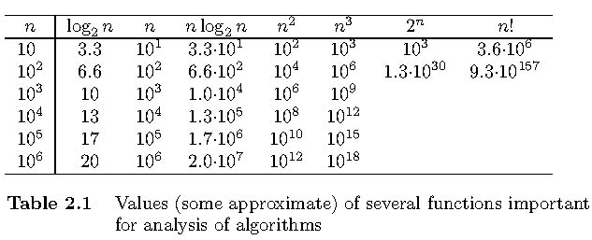
Values of some important functions as n → ∞

Slide 12
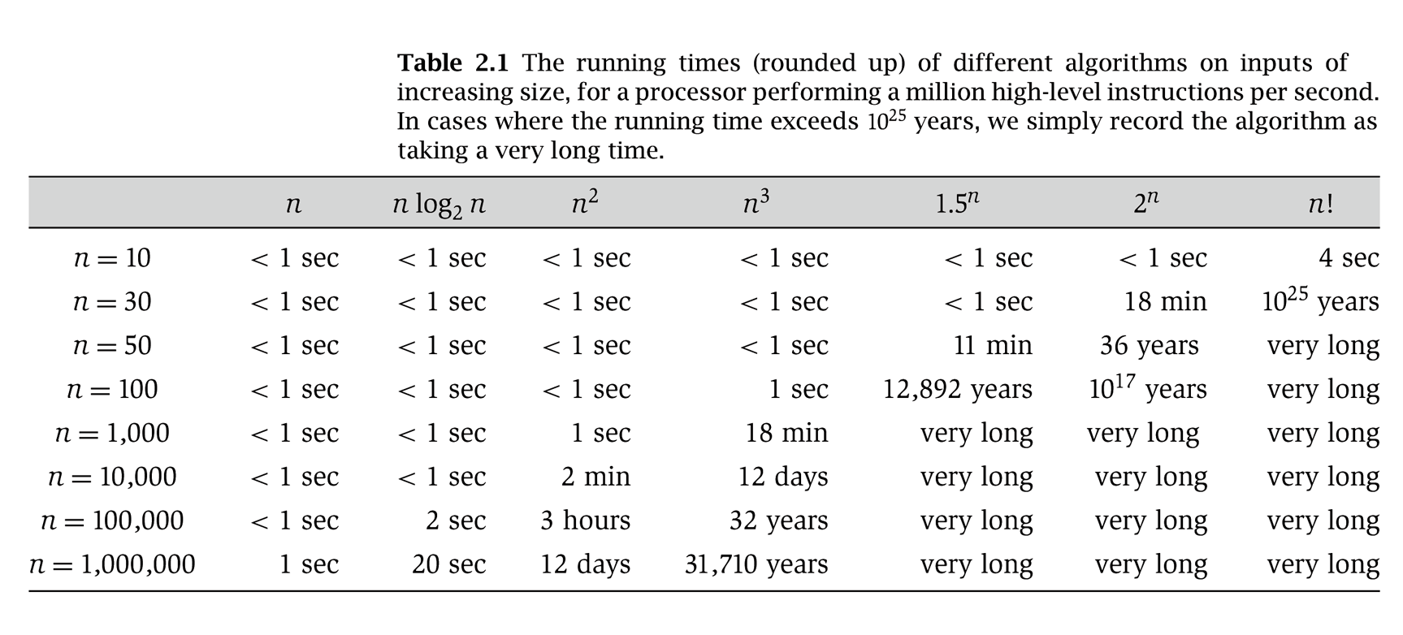
Why It Matters
Notes:
table taken from More Programming Pearls, p. 82, 400MhZ Pentium II scaled up
one step takes one nanosecond
msec = millisecond

Slide 13
Orders of Growth – some facts
log_{a}n = log_{b}n * log_{a}b
Note: log_{a}b is a constant (does not depend on n)
  e.g. log₁₀ n = log₂n * log₁₀2 (log₁₀2 is a constant)
  So just write log n (don’t need to specify base of log)
2^{n} and n! - both called exponential growth functions
  For a computer making 1 trillion = 10 ¹² operations / second
    2¹⁰⁰ operations will take 4. 10 ¹⁰ years = 40 billion years
    Age of the planet earth is 4.5 billion years
    100 ! operations will take much more

Slide 14
Best-case, average-case, worst-case
For some algorithms efficiency depends on particular input, not just input size (it may be faster on some particular input e.g. in sequential search):
Worst case: C_{worst}(n) – maximum # of operations over inputs of size n
Best case: C_{best}(n) – minimum # of operations over inputs of size n
Average case: C_{avg}(n) – “average” # of operations over inputs of size n
  Number of times the basic operation will be executed on typical input
  NOT the average of worst and best case
  Expected number of basic operations (considered as a random variable) under some assumption about the probability distribution of all possible inputs (e.g. all possible inputs are equally likely)

Slide 15
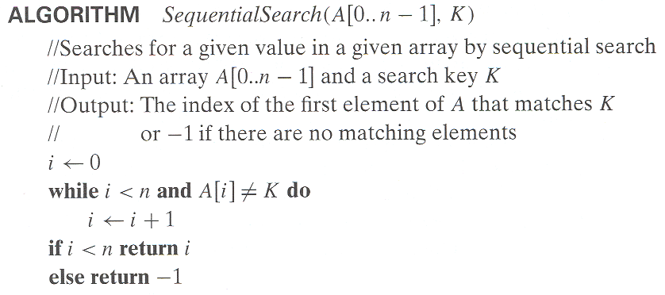
Example: Sequential search
Worst case = n (Unsuccessful search i.e. not found)
Best case = 1 (Found in the 1st try – index 0)
Average case = ?

Slide 16
Average Case Efficiency for Seq. Search
Assumptions:
  The prob. of successful search is p (e.g = ½ )
  The prob. of finding the match at position i is equal for all I
➔ the prob of finding the match at any posn i will be p/n
The number of comparisons if item is found at posn i is i
The number of comparisons if item is not found is n
Cavg(n) = average # of key comparisons (over all possible inputs)
= 1*p/n + 2*p/n + ….. + i*p/n + … + n*p/n + n(1-p)
= p(n+1)/2 + n(1-p)
If p = 1
then Cavg(n) = (n+1)/2 = (approx ½ the input size)
= average of the best and worst case (coincidently!)

